Slide 1

Data 340 Data Mining
Profitability Analysis of Business Categories (2015–2025)
- Anoushka Gurung

Slide 2
Data Mining Methodology
Data Discovery and Exploration
Pre-Processing
Data Mining
Information Developement
Outcome Communication
Post-Processing
Defined Question:
Can we predict whether a customer’s experience will be Positive or Disappointing based on financial data?
Tools Used:
Orange Data Mining (Decision Tree), Excel (Data cleaning)
Approach:
Clean and prepare dataset in Excel
Import into Orange
Build and evaluate a classification model
Interpret key decision rules and insights

Slide 3
Each Data Mining Journey is unique
Data Discovery and Exploration | Specify the Question and scope the answer, Obtain the Data
Pre-Processing | Data Summaries (Categorical, Numeric), Identification and Summarization of Data Issues (Null, Missing, Corrutped values,etc.), Feature Selection, Dimensionality Reduction, Normalization, Data Subsetting
Data Mining | Resolving Data Issues, Performing Analysis
Post-Processing | Statistical Testing, Significance Testing, Sampling of Instances, Hypothesis Testing
Information Development | Analysis Outcomes, Data Review, Data Issue Summary,
Outcome Communication | Answering the Specific Questions, Report formation, and messaging
Began with raw Excel dataset containing profitability and experience fields
Some records had missing or inconsistent profit values → corrected
Imported the cleaned data into Orange for modeling
Created a workflow using File → Select Columns → Decision Tree → Test & Score → Data Table
Documented each step and observed how model results changed as data improved

Slide 4
Data Discovery and Exploration
Dataset: Classification_exercise_beginning.xlsx
Variables explored: Profit, Revenue, Order Count, Customer Experience
Target variable: Customer Experience (Positive / Disappointing)
Reviewed distributions to identify outliers or missing data
Developed understanding of which variables might drive satisfaction

Slide 5
Pre-Processing
Removed any missing or invalid entries
Standardized variable names and formats
Selected relevant features:
Predictors: Profit, Revenue, Order Count
Target: Customer Experience
Verified data types and converted categorical values as needed
Saved cleaned version for use in Orange

Slide 6
Data Mining
Used Decision Tree algorithm in Orange
Defined Customer Experience as target variable
Trained model using Profit, Revenue, and Order Count as predictors
First tree split: Profit > 2368.14 → mostly Positive experiences
Used Test & Score widget to measure accuracy
Evaluated the structure and logic of the tree

Slide 7
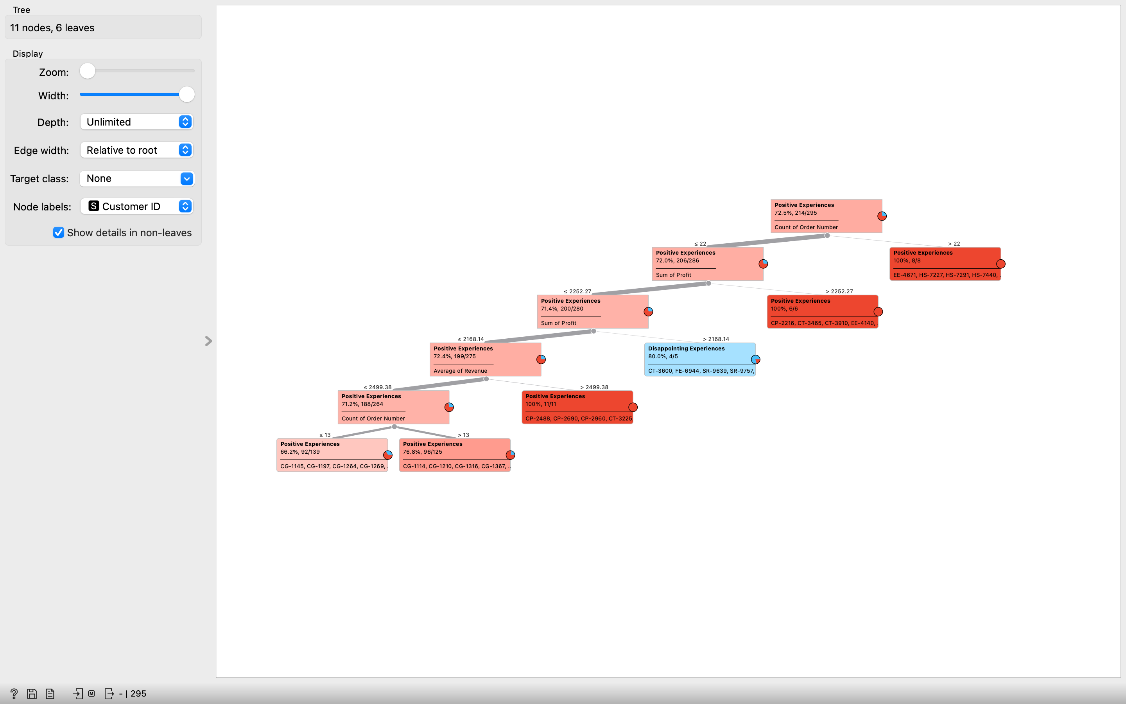

Slide 8
Post Processing
Interpreted the decision tree to identify main drivers of experience
Compared predictions to actual customer outcomes
Observed pattern:
  High-profit customers → mostly positive experiences
  Low-profit, low-revenue customers → more disappointing experiences
Accuracy score verified model performed better than random guessing

Slide 9
Information Development
Profit and revenue strongly influence experience outcomes
Profit threshold ≈ 2368 separates positive from disappointing customers
Order count plays a secondary but supportive role
Visual workflow in Orange clearly mapped these relationships
Financial performance is a meaningful indicator of customer satisfaction

Slide 10
Outcome Communication
Conclusions:
The decision tree successfully classified customer experiences
Higher profit = higher likelihood of positive experience
Orange made the analysis visual, simple, and interpretable
Recommendations:
Focus on improving low-profit customer segments
Add new variables (e.g., service time, product quality) for future models
Continue using Orange for quick, visual machine learning insights

